Slide 1
New Assigning Software – Game Officials.Net
RESPECT
AN EXCITING NEW PROGRAM FOR MICHIGAN OFFICIALS…
USSF in Michigan is changing the assigning software used for all Select, Premier (fall 2014), State Cup and other game assignments starting with the Spring 2014 Season. This is also the same software that GVSA and GLCSL will use for most games.
The following slides are intended to give officials an overview of the changes and what needs to be done to prepare and get future assignments.
Officials are requested to use February and March 2014 to set up their profile so that assignments can begin in March/April 2014
Notes:
Log-In Screen – is the same as the recertification log-in for referees and assignors

Slide 2
New Assigning Software – Game Officials.Net
RESPECT
As soon as USSF has added your name and number to the database you can access GameOfficials.net through the below screen.
Notes:
Log-In Screen – is the same as the recertification log-in for referees and assignors

Slide 3
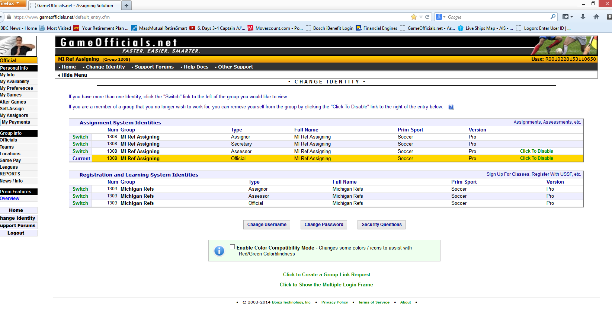
New Assigning Software – Game Officials.Net
RESPECT
There are two parts of this software for all referees which are “Assignment System” and “Registration and Learning System”. Your first step after log-in is to change identity to “Official in the Assignment System”.
Notes:
After Log-In, select the identity for getting game assignments.

Slide 4
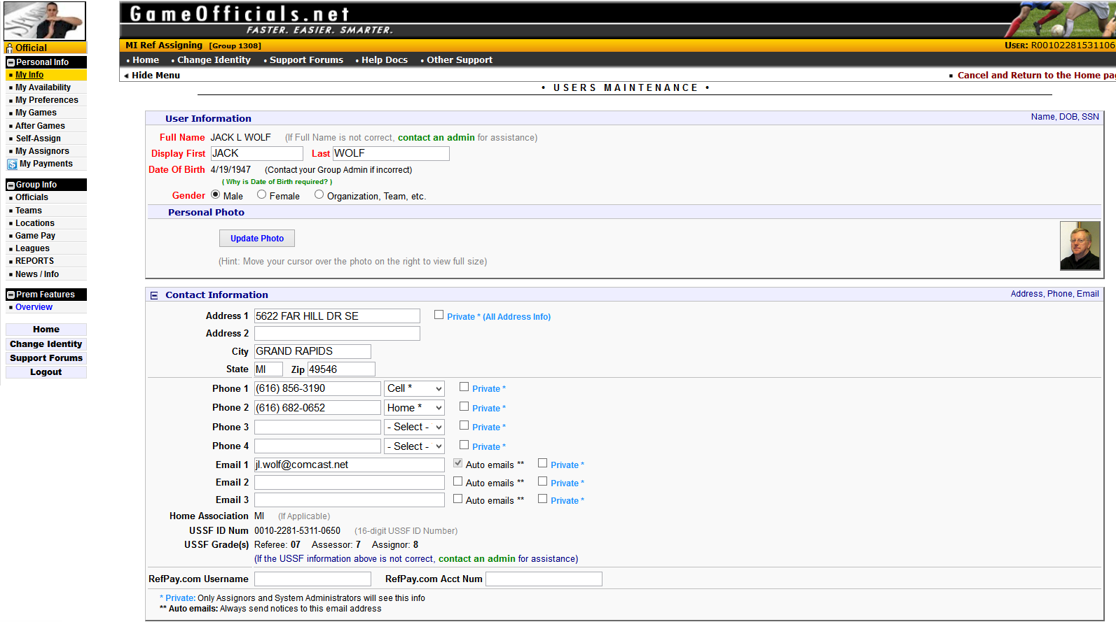
New Assigning Software – Game Officials.Net
RESPECT
The next step is select “My Info” on the left side menu and set up your personal information and make sure to save this when finished.
Notes:
The menu on the left give referees an easy navigation screen.

Slide 5
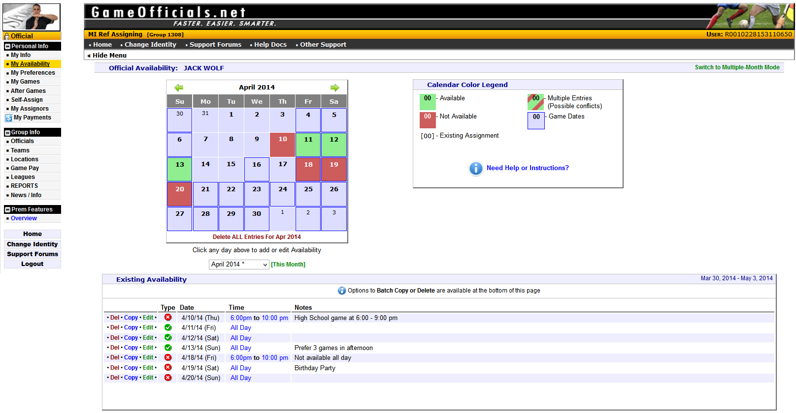
New Assigning Software – Game Officials.Net
RESPECT
Then next select “My Availability” on the left side menu and set up both the dates that you can and cannot work. If you leave this blank you will only be given assignments when others who are qualified and marked the date as available have been assigned. You need to keep this up to date.
Notes:
The menu on the left give referees an easy navigation screen.

Slide 6
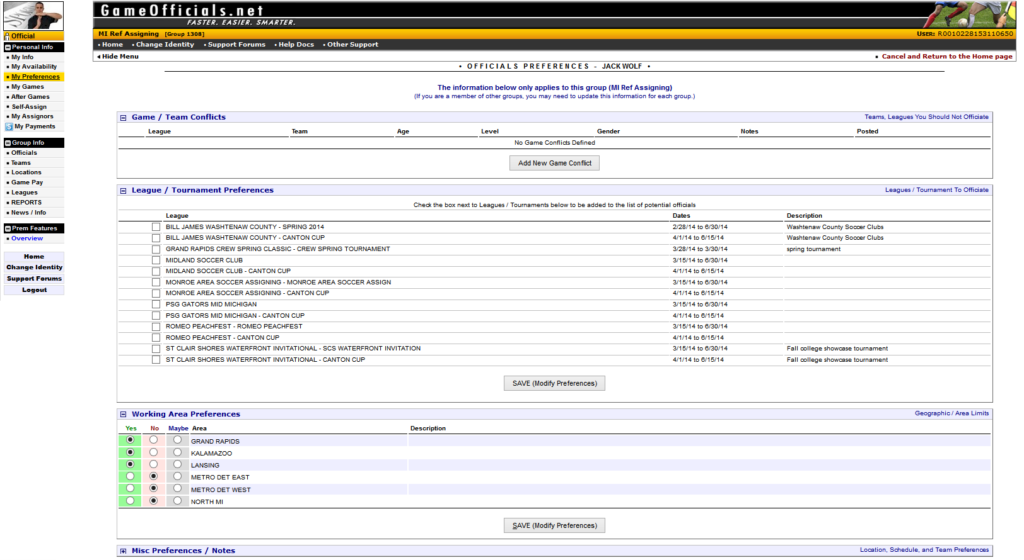
New Assigning Software – Game Officials.Net
RESPECT
Next select “Preferences” on the left side menu and set up your preferences with area and leagues that you want to work for. If the League “GVSOA Spring 2014” is shown then select this. Don’t forget to “Save”.
Notes:
MY INFO – Make sure to update the personal information and add a photograph. Also not the private tabs next to phone and email information.

Slide 7
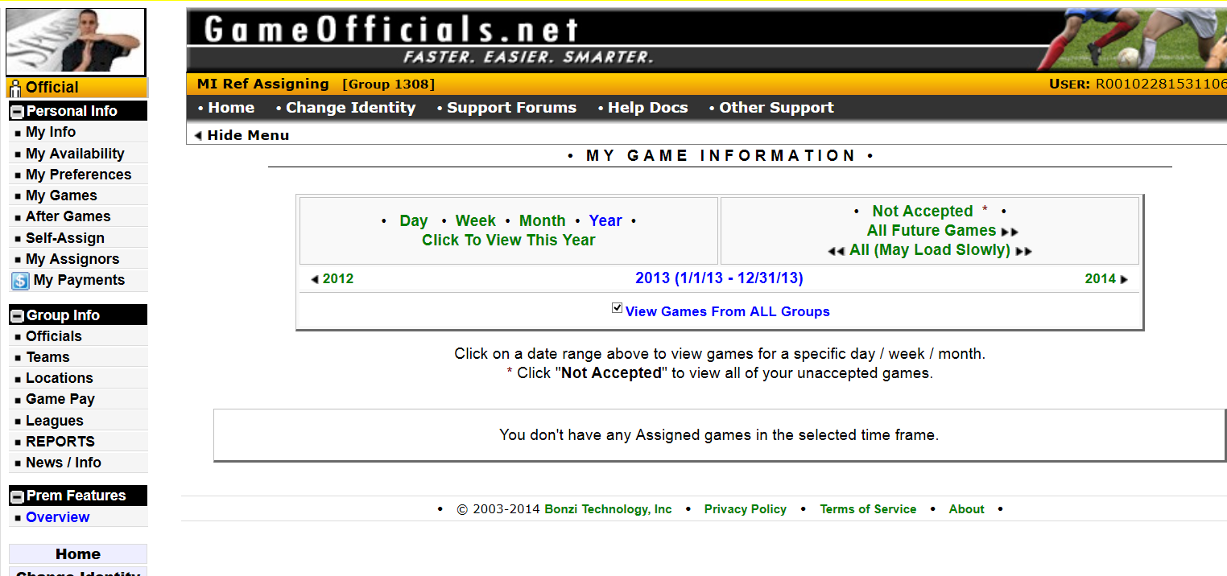
New Assigning Software – Game Officials.Net
RESPECT
Under “My Games” on the left side menu you will be able to see all of your current, future and past game assignments.
Notes:
MY PREFERENCES – Next, Officials must update preferences including areas to work and days available and travel information.

Slide 8
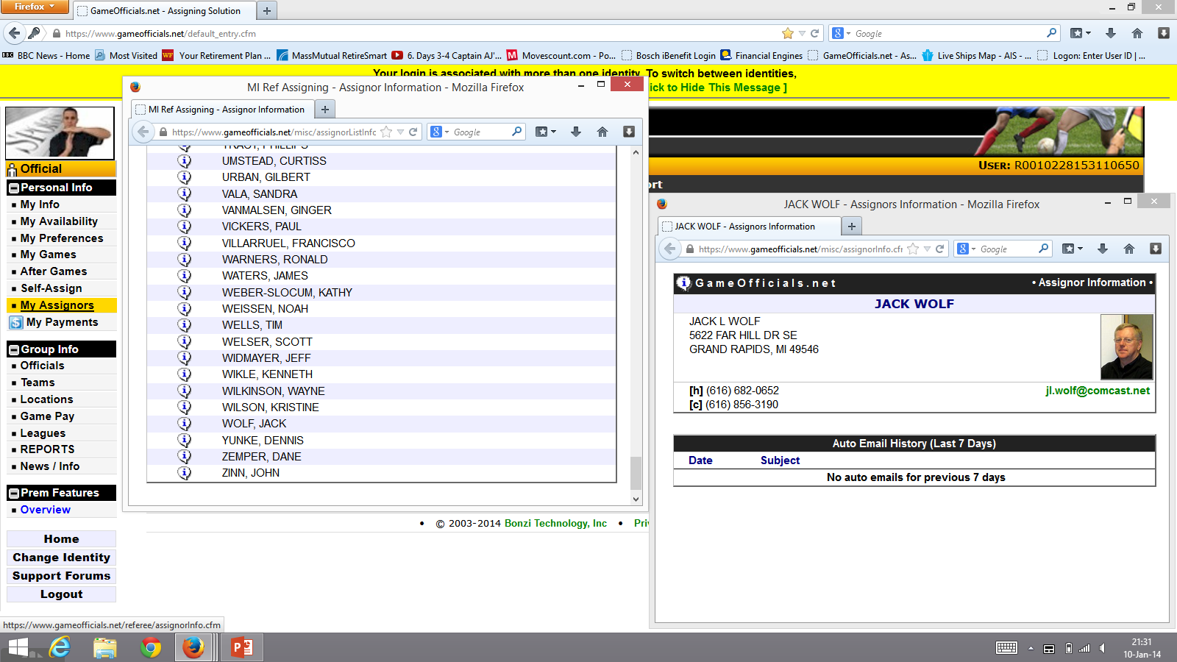
New Assigning Software – Game Officials.Net
RESPECT
Under “My Assignors ” and “Officials” on the left side menu you will be able to see details and contact information of your assignors and the officials that you will work with. Youth officials information is protected.
Notes:
MY PREFERENCES – Next, Officials must update preferences including areas to work and days available and travel information.

Slide 9
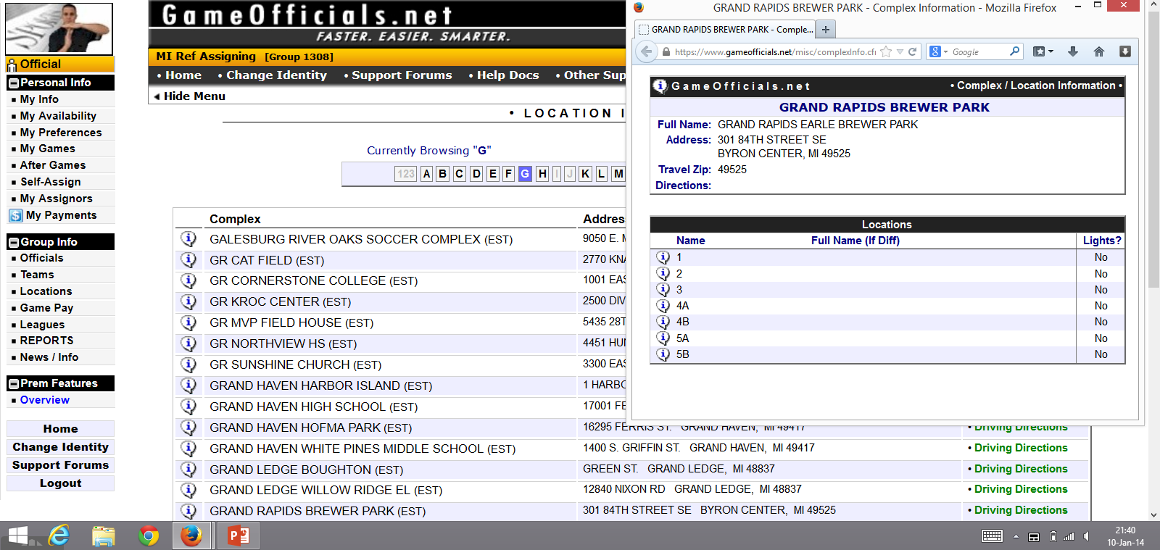
New Assigning Software – Game Officials.Net
RESPECT
Under “Locations ” on the left side menu you will be able to see details and get driving directions to all field locations for your games.
Notes:
MY PREFERENCES – Next, Officials must update preferences including areas to work and days available and travel information.

Slide 10
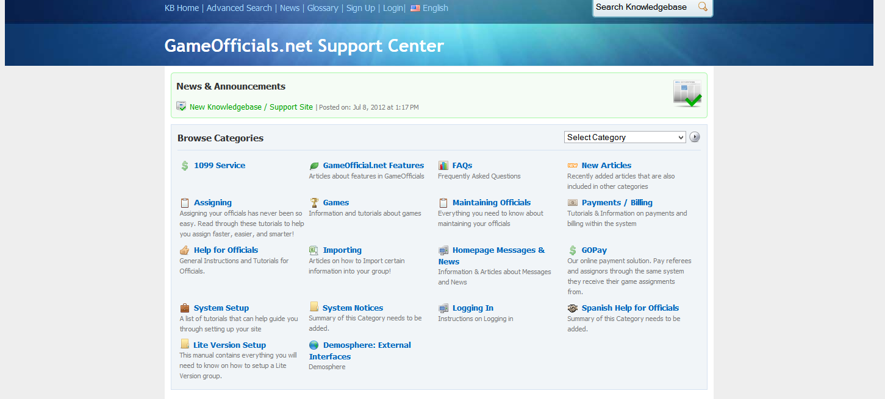
New Assigning Software – Game Officials.Net
RESPECT
Under “Help ” you can access the support center and search the knowledge base for helpful information.
Notes:
HELP – A good selection of training and materials

Slide 11
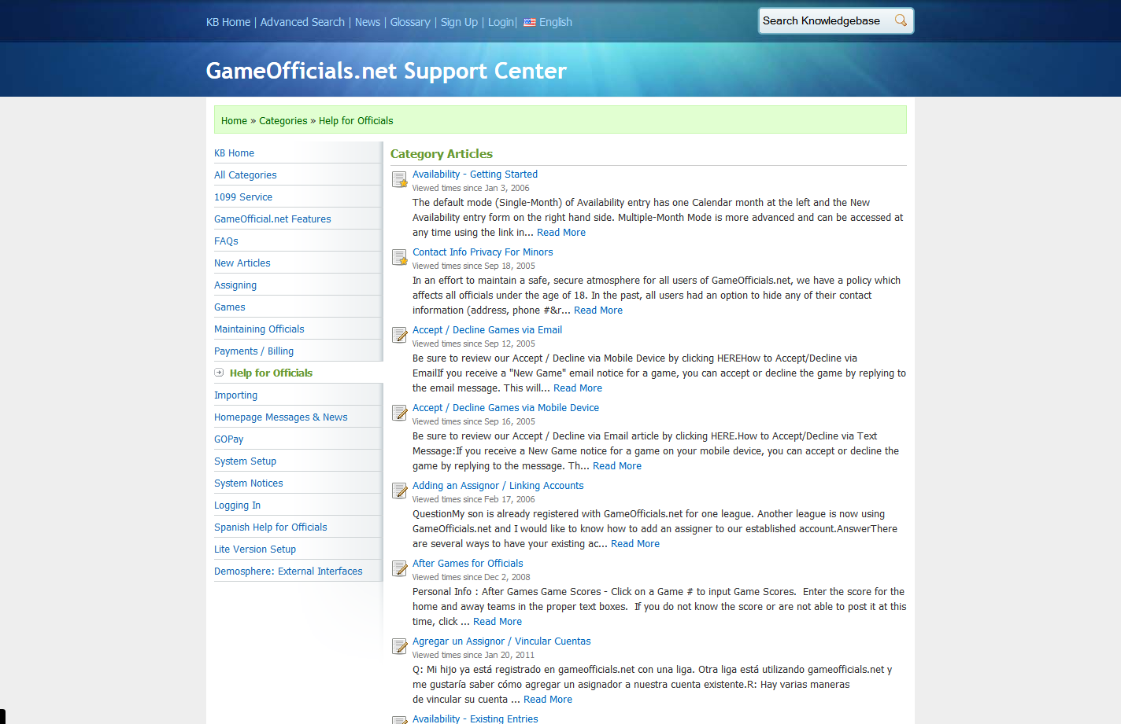
New Assigning Software – Game Officials.Net
RESPECT
Under “Help ” you can access the support center and search the knowledge base for helpful information.

Slide 12
New Assigning Software – Game Officials.Net
RESPECT
Thanks for your efforts to implement this new program and take advantage of its many exciting and helpful new features!
Questions?

