Slide 1
GVSOA Fall Kick-off 2015
What you are available for vs. what the assignor sees.
Or, does not see…

Slide 2
In order for the assignor to see what you save, you have to save it where we can see it.
Sign into 1308- assignment system identity.
do not sign into 1303- registration and learning
AT LEAST enter when you are available. You can also
show blocks- but that does not tell us when you are available…
AT LEAST save to Michigan Ref Assigning (1308)
do not only save to Michigan Refs (1303)
Or you can save to Michigan Ref Assigning & Michigan Refs
Unless there is a prompt to check for specifics, we probably won’t.

Slide 3
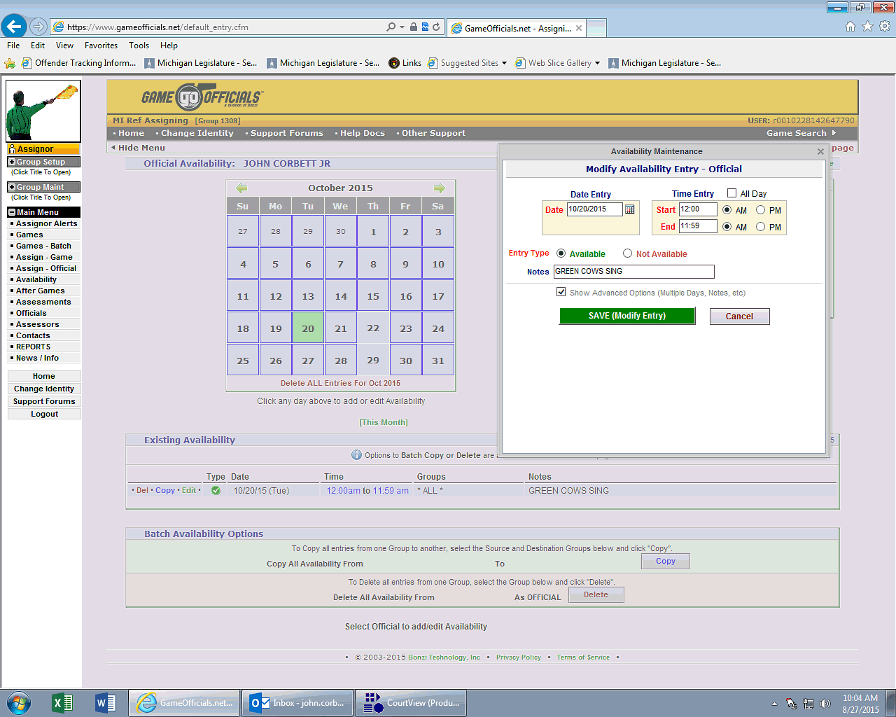

Slide 4
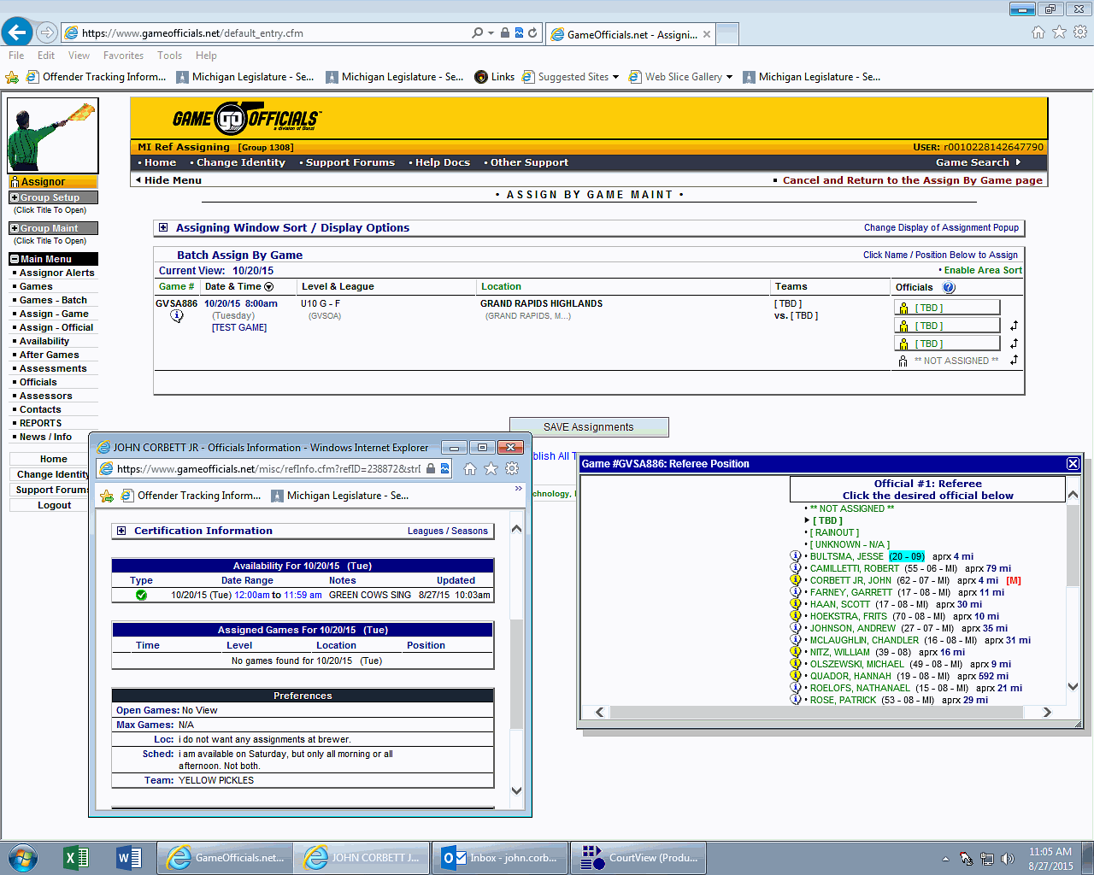

Slide 5
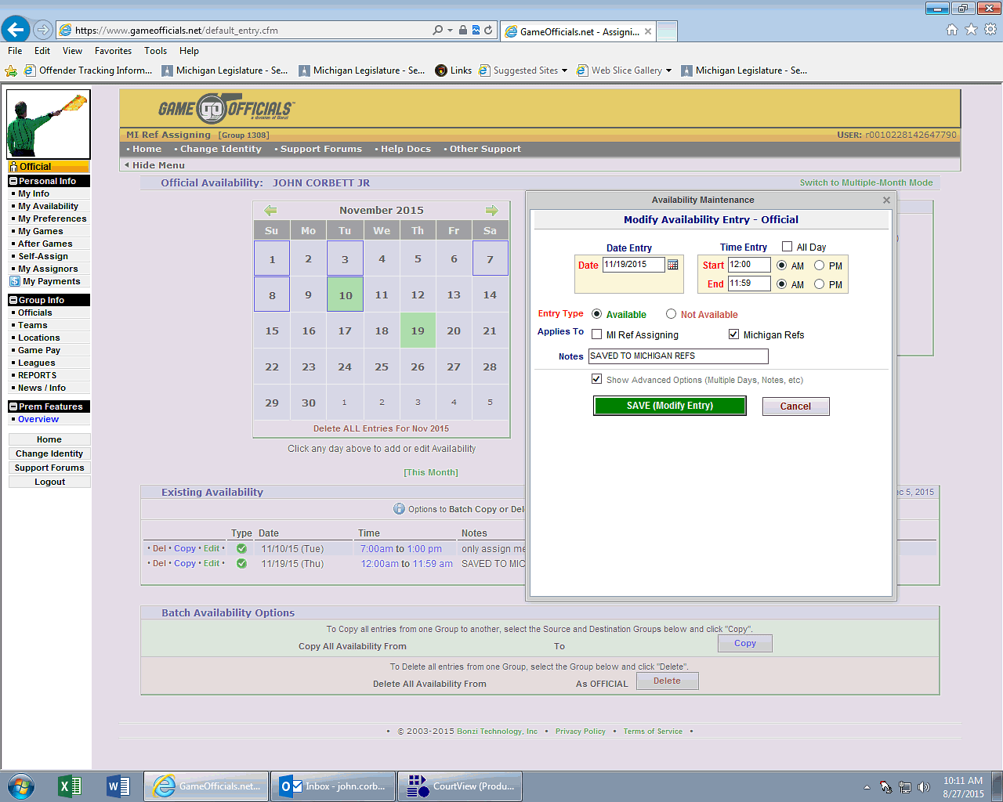

Slide 6
